Slide 1
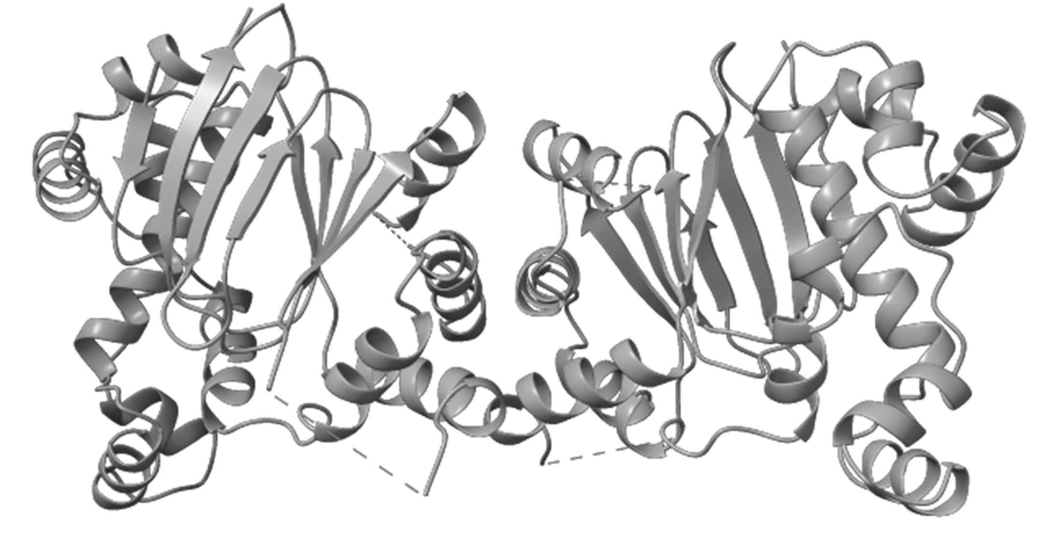
Exploring the Impact of Fatty Acid Binding on RegA
Grace Lawhern
Final Project
06/03/24

Slide 2
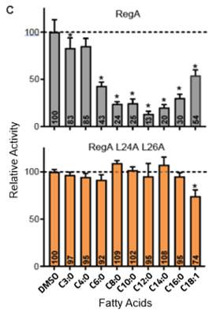
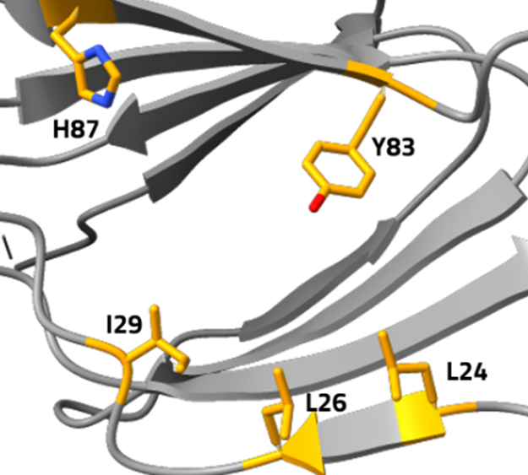
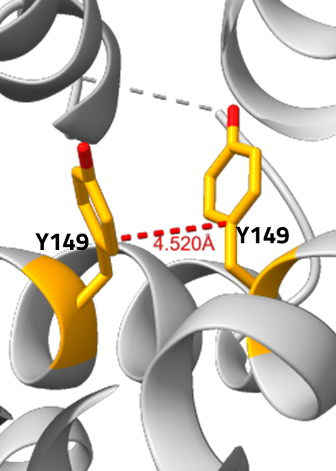
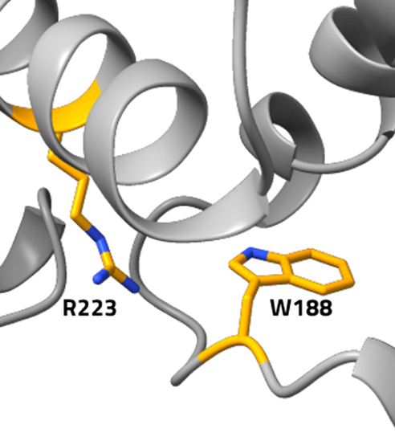
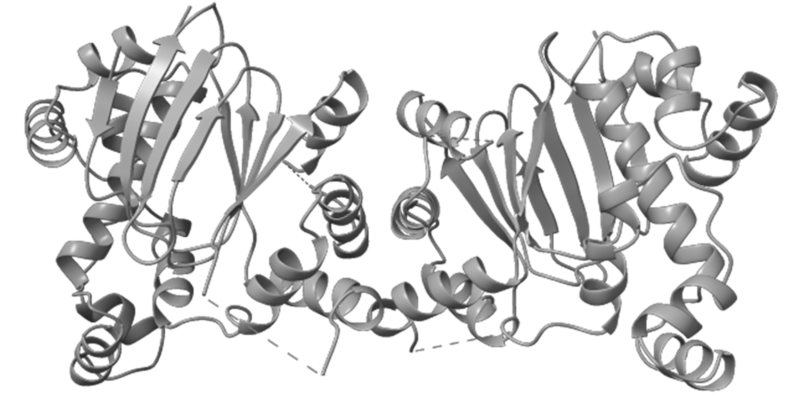
Various Fatty Acids Inhibit Virulence Regulator RegA
Decanoic acid: C10 (“weakest”)
Myristic acid: C14 (“strongest”)
Palmitic acid: C16

Slide 3
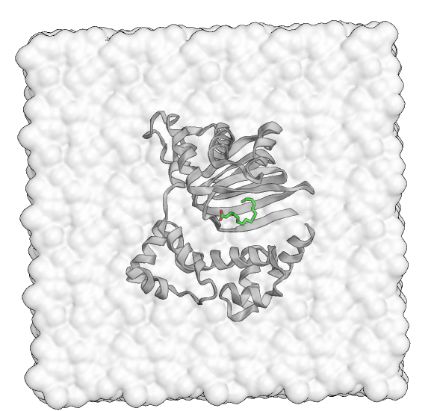
AF3 Generated FA-Bound Structures Allow for Molecular Dynamics Simulations
Methods
Generate ligand-bound structures via AF3 and alignment
Remove N-term and C-term loops
“making it rain” openMM protein only and protein-ligand
Amber ff19SB
TIP3P
12A box size
NaCl counter ions
Constant: 300K and 1bar
700 kJ/mol force constant
5ns equilibration, 300ns simulation
Stride by 5 to give 6000 frames

Slide 4
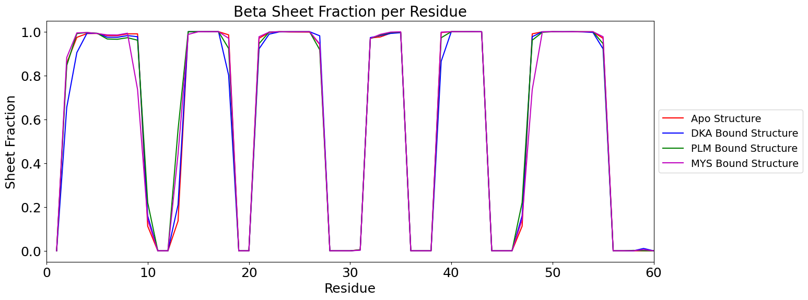
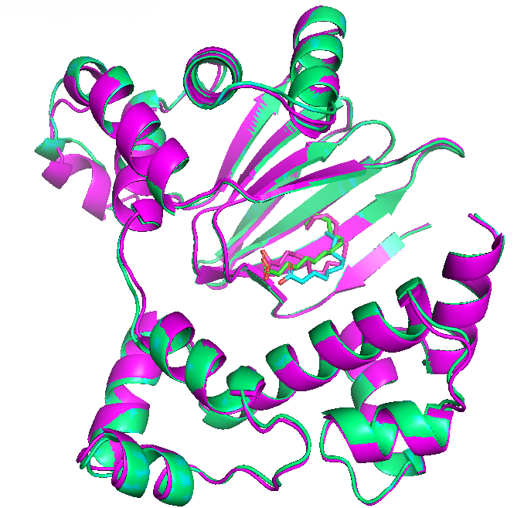
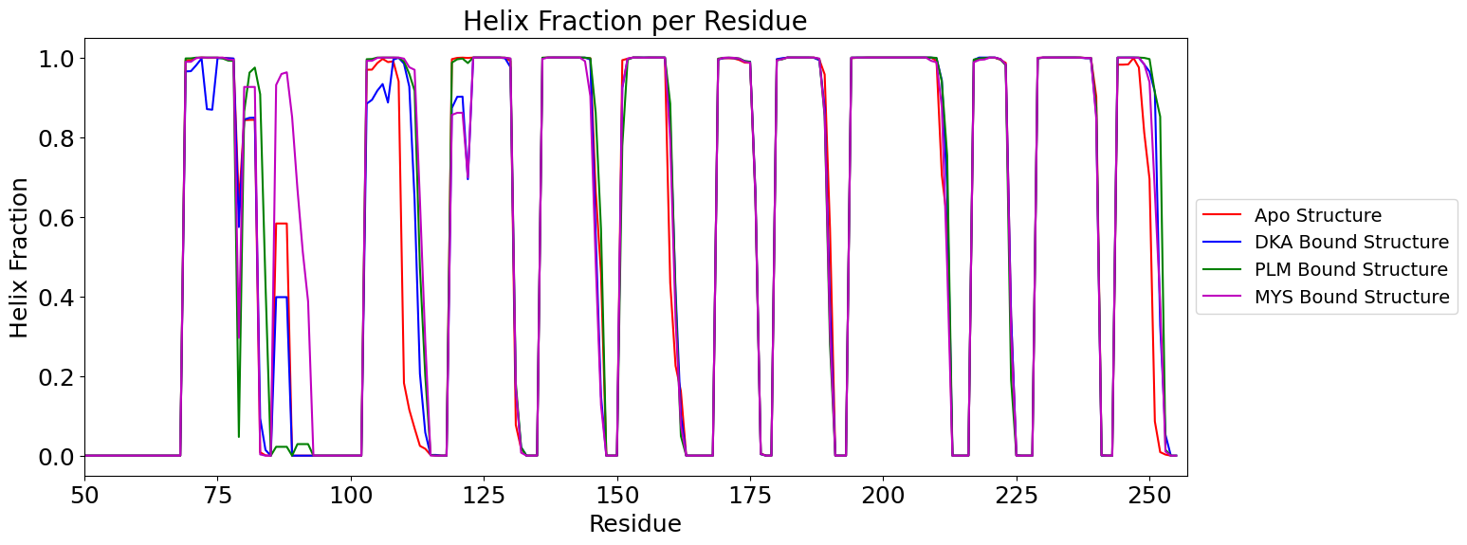
Results:

Slide 5
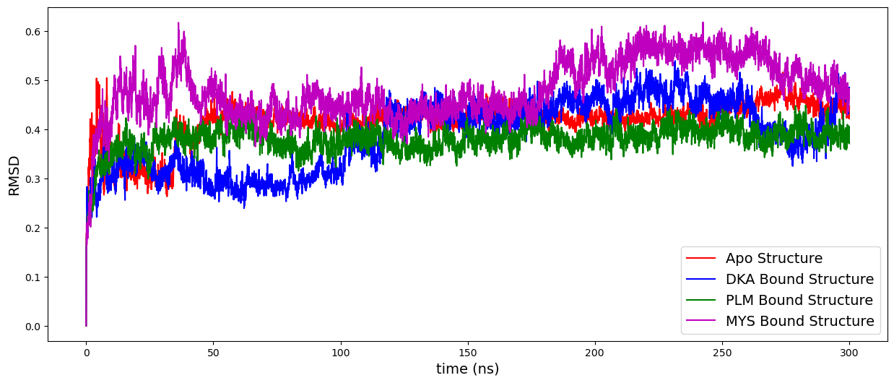
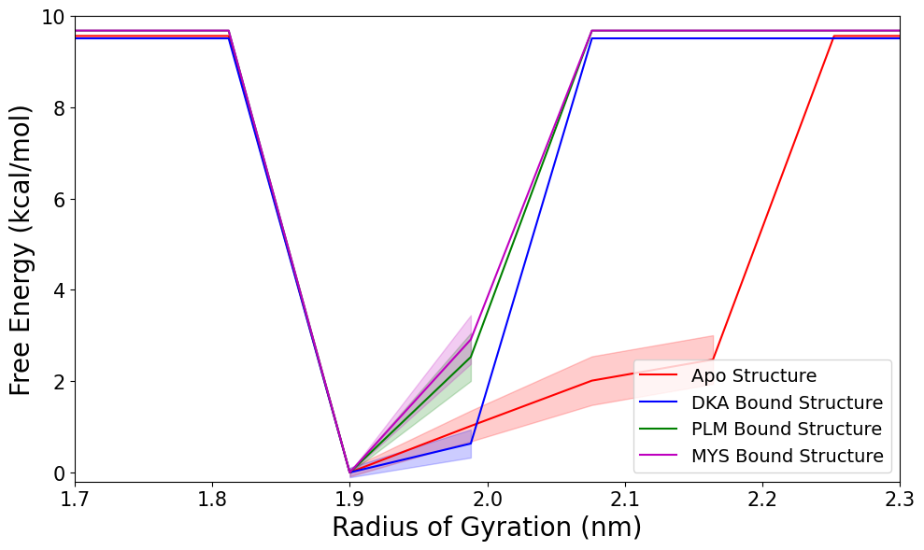
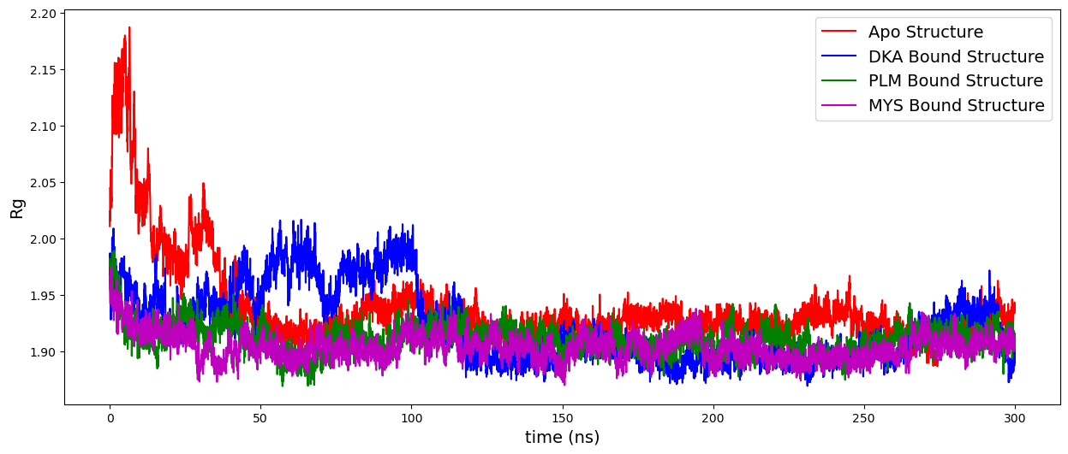
Results:
More rigid with ligand bound
Some variation
Rg for DKA bound
RMSD for MYS bound
Notes:
Destabilizaiton with higher free energy
More rigid with narrow basin

Slide 6
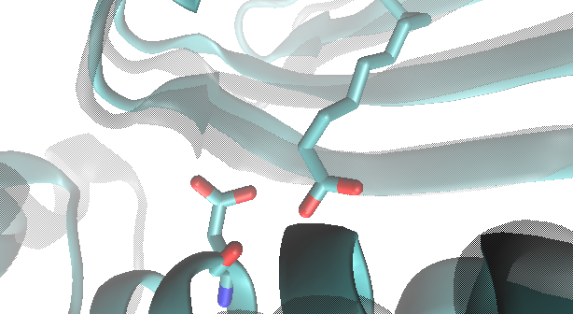
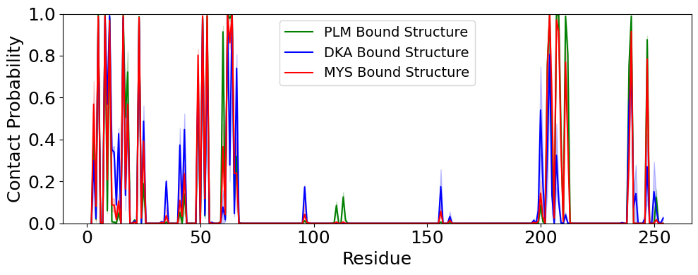
Results:
DKA
Share major contacts
Display some variation around residues 200-220
Arg200

Slide 7
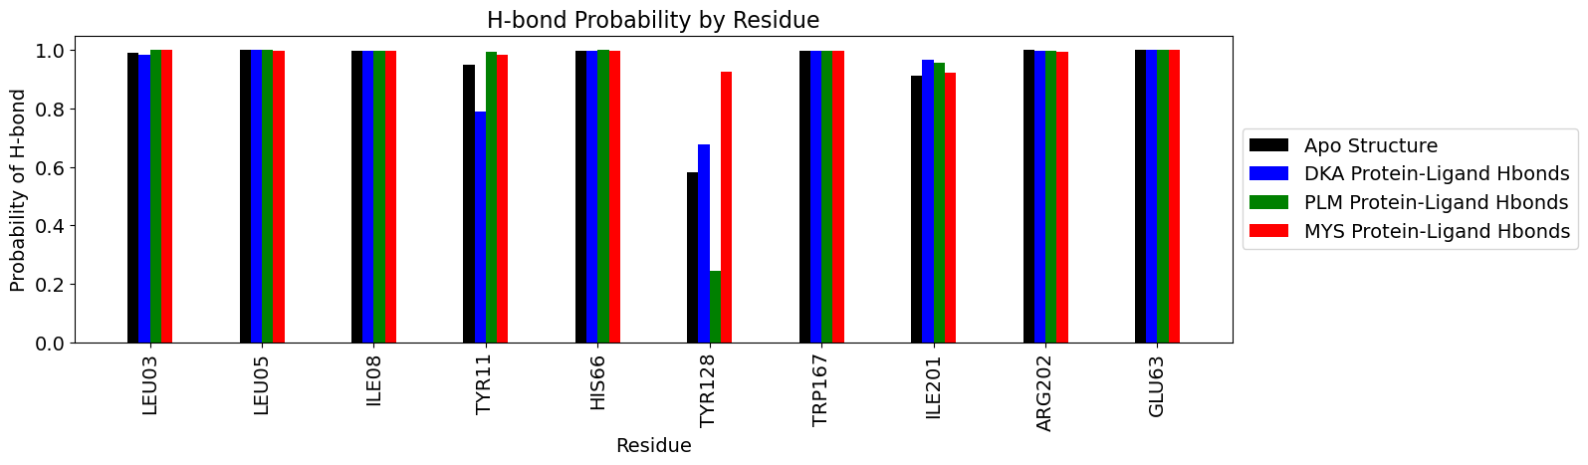
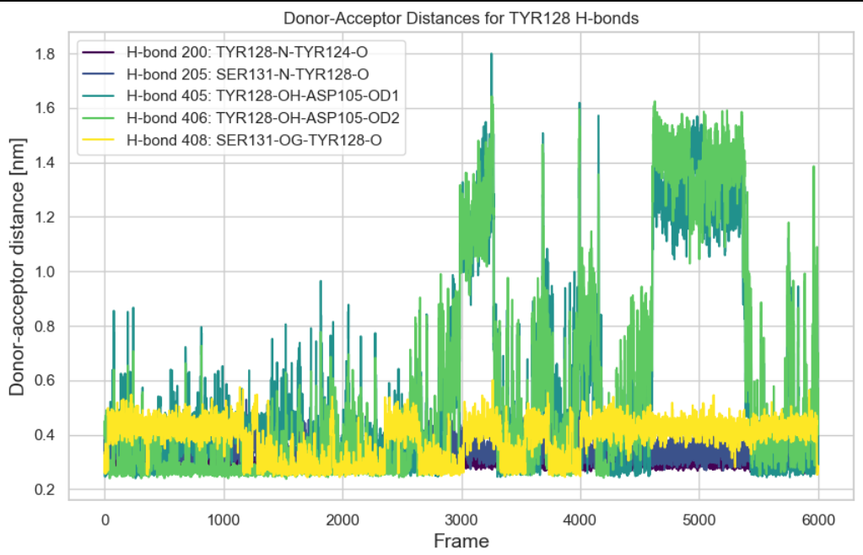
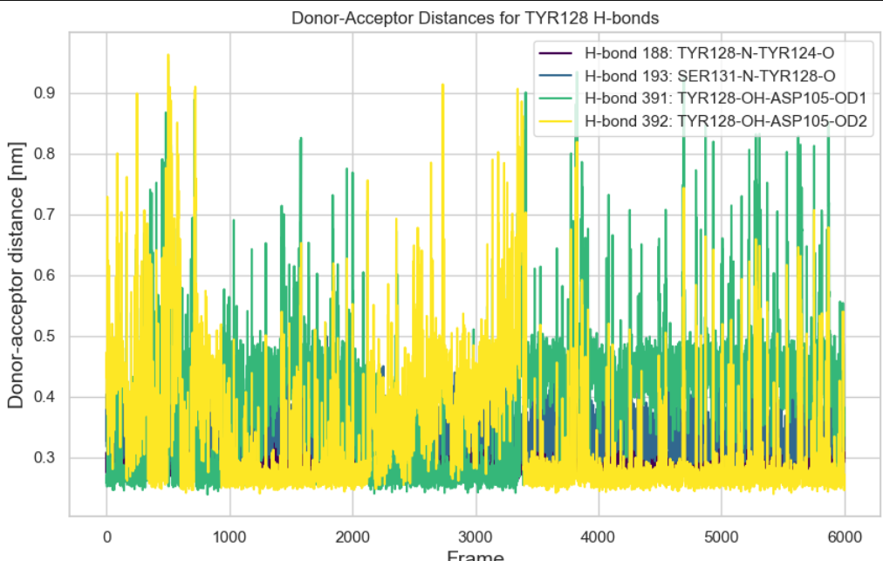
Results:
DKA
PLM

Slide 8
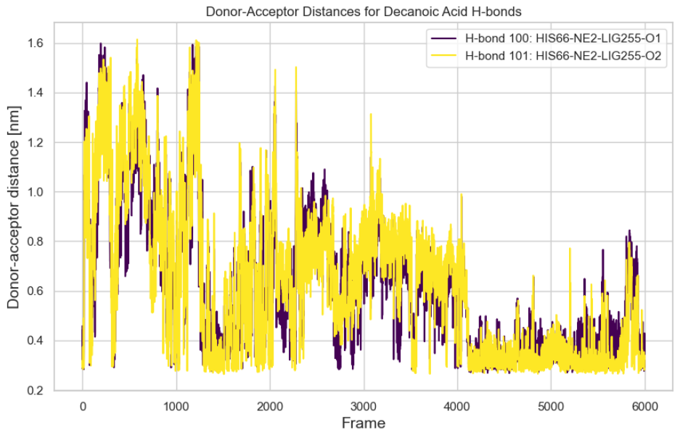
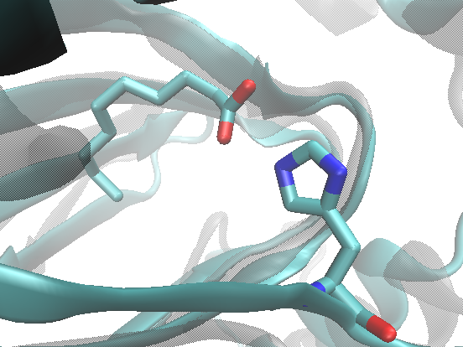
Results:
DKA
His66
Frame 4500

Slide 9
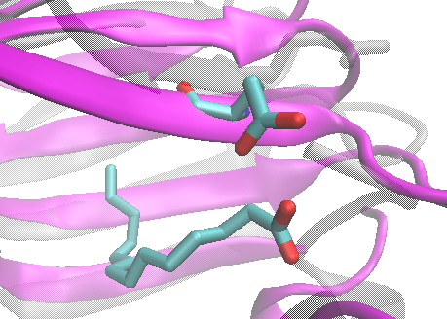
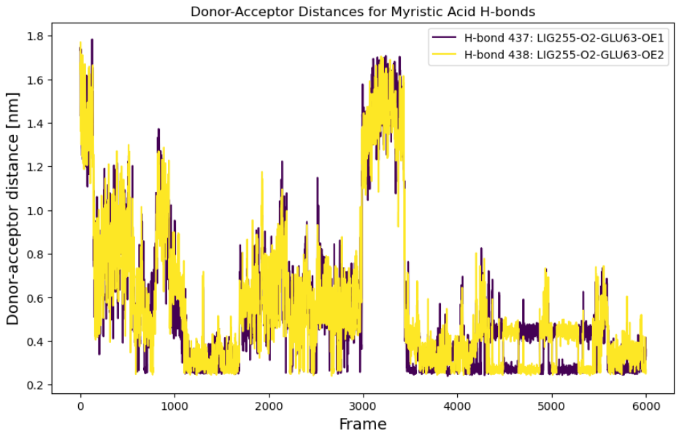
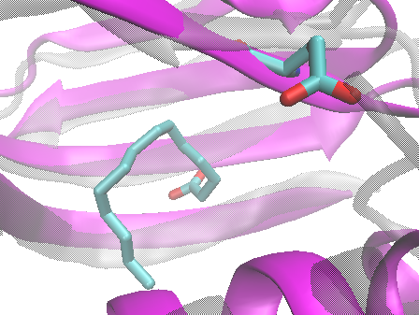
Results:
Glu63
MYS
Frame 4000
Glu63
MYS
Frame 3100

Slide 10
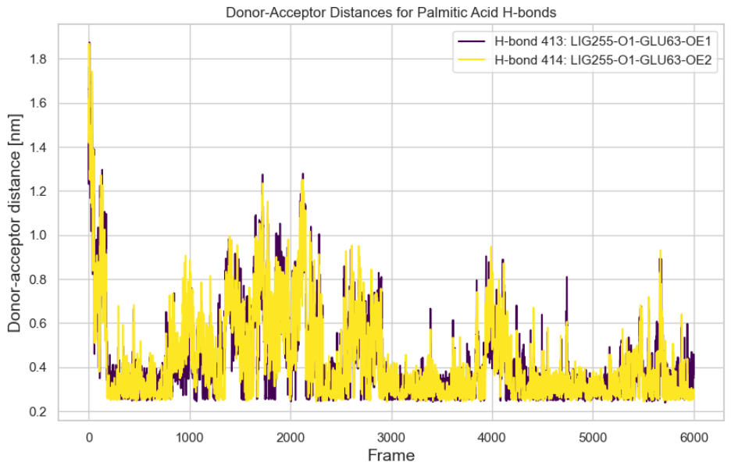
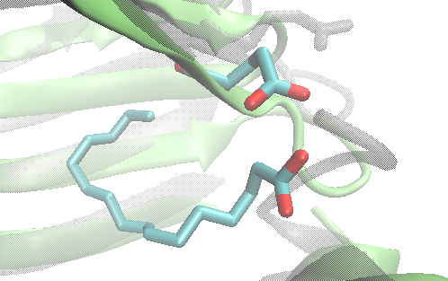
Results:
Glu63
PLM
Frame 4500

Slide 11
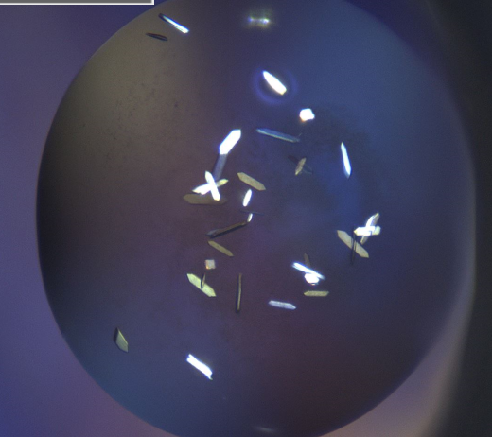
Summary
AF3 is a powerful tool for structural biologists
RegA flexible loops
Inform mutagenesis endeavors (Glu 63)
Despite high structural similarity, these ligands display some unique behaviors
H-bonding residues
Variation at the dimer interface
These results are only scratching the surface.

Slide 12
Thank you!

Slide 13
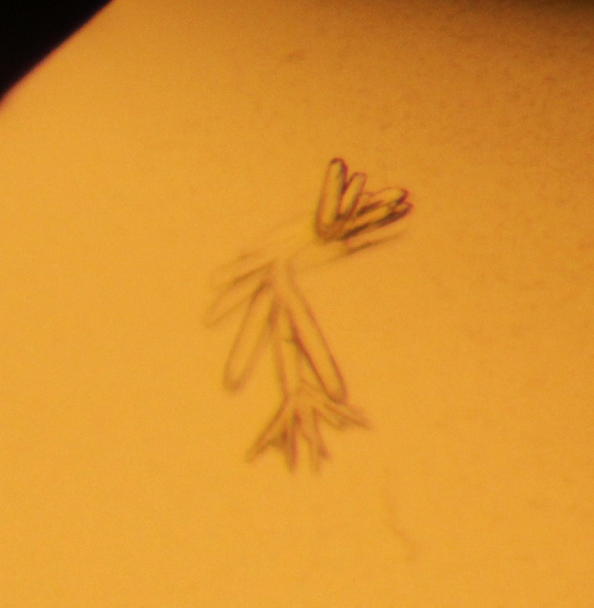
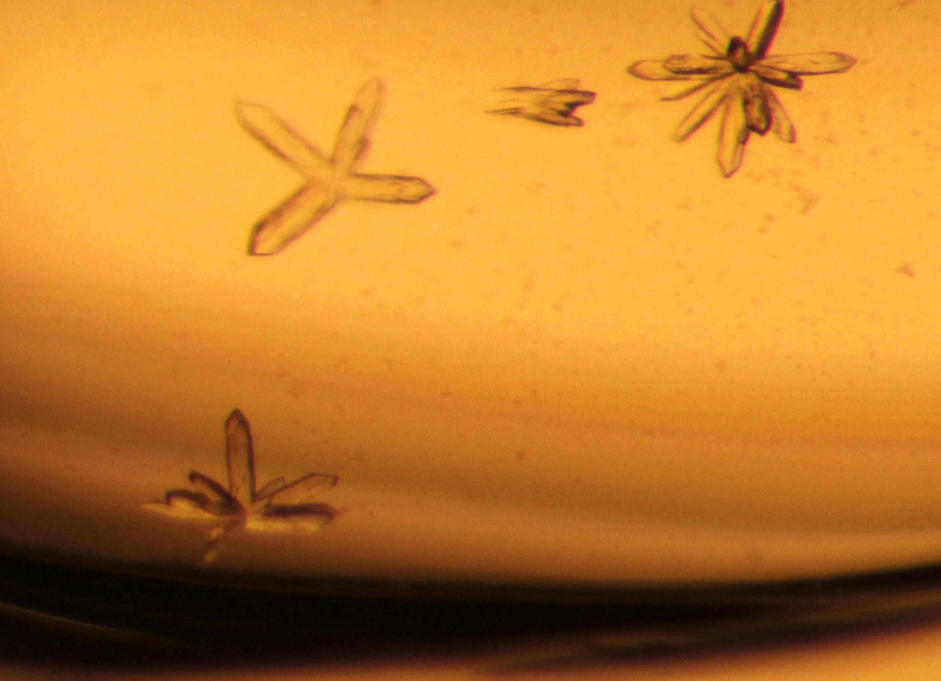
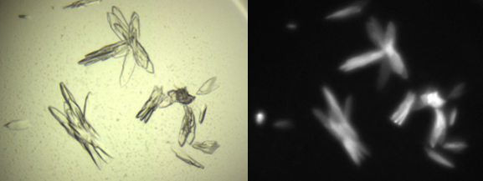
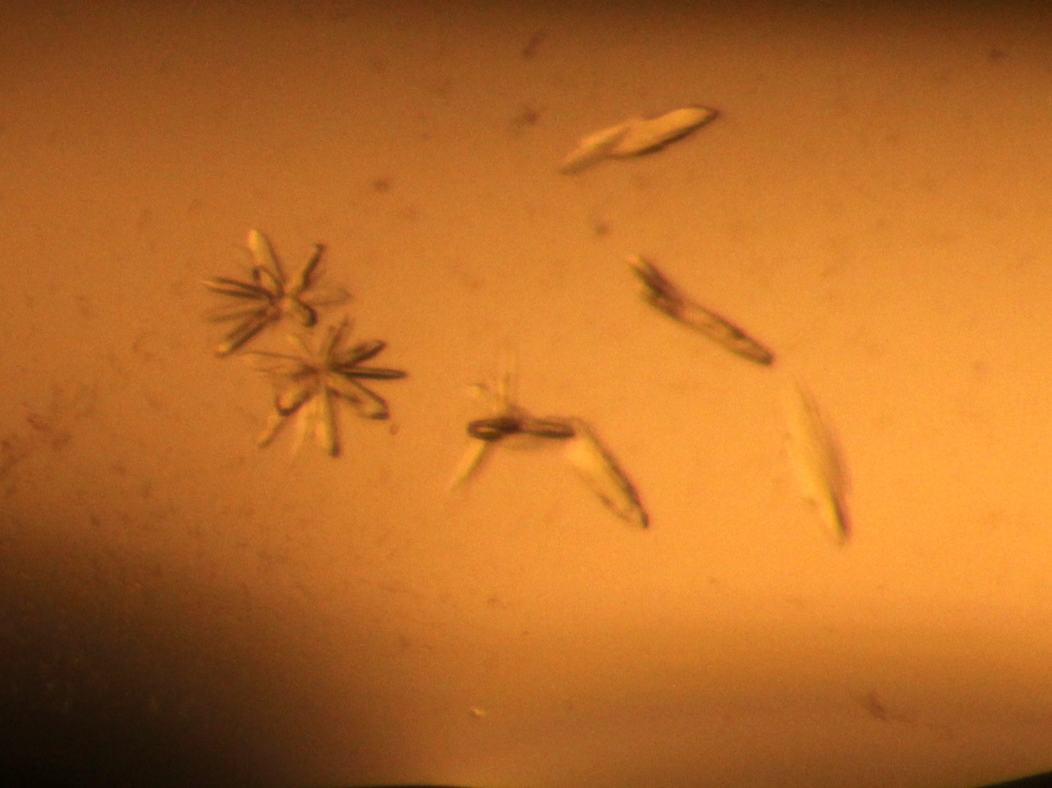
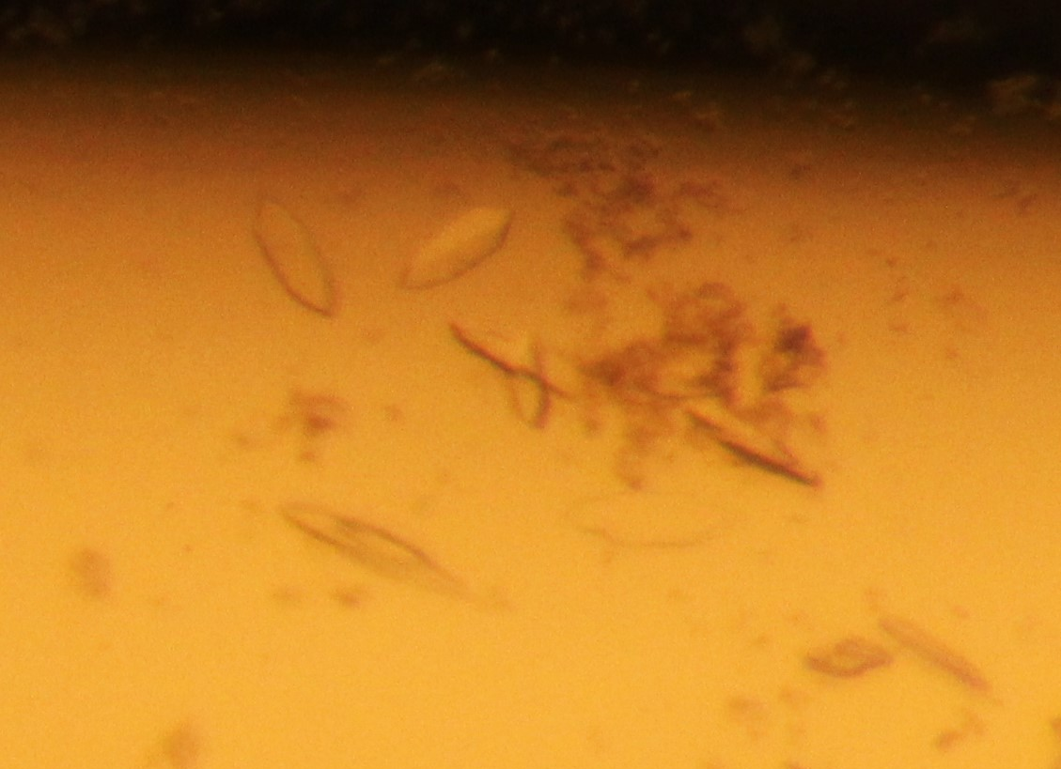
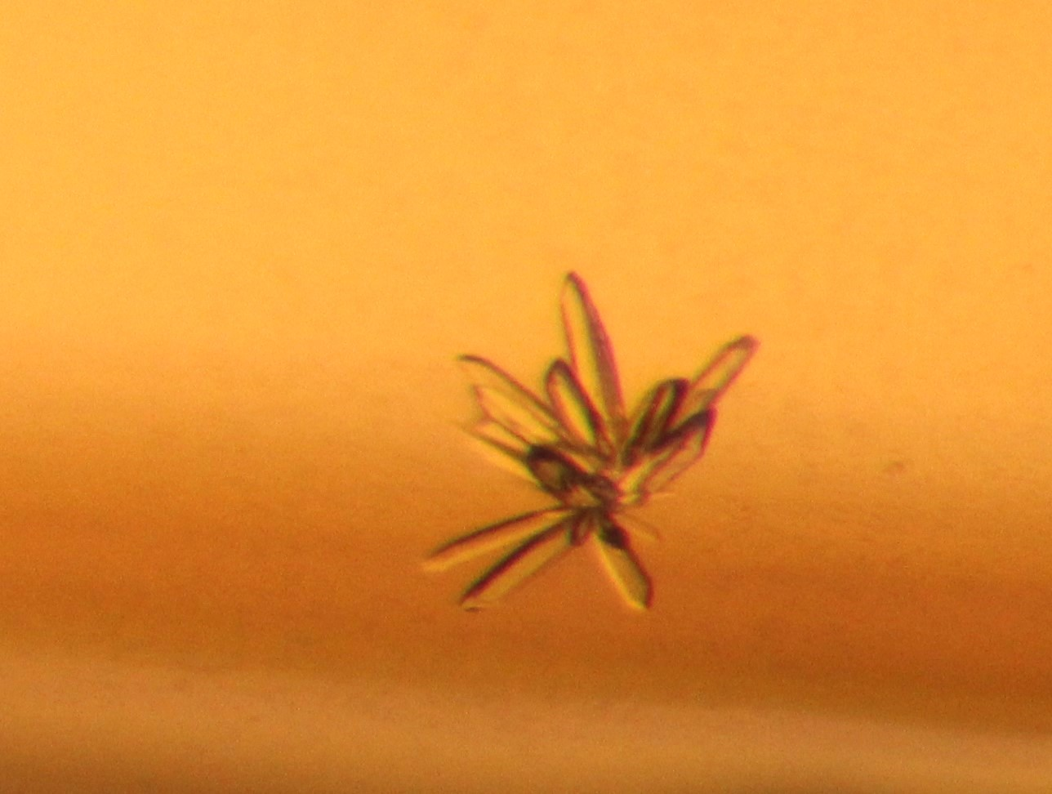

Slide 14
